Slide 1
Lokomo’s Sickness Fund
Welcome event 2024
Taina Tuominen

Slide 2
What is Lokomo’s Sickness Fund?
Workplace fund
Established in 1917
In operation according to the Health Insurance Act since 1974
Current number of individuals insured 3042, of whom 401 are retired or other insurees
The Sickness Fund office is located at Metso Finland Oy’s factory on Lokomonkatu in Tampere
Officials
  Taina Tuominen, CEO
  Hanna Hautamäki, Insurance Secretary
  Sirpa Olán, Insurance Secretary

Slide 3
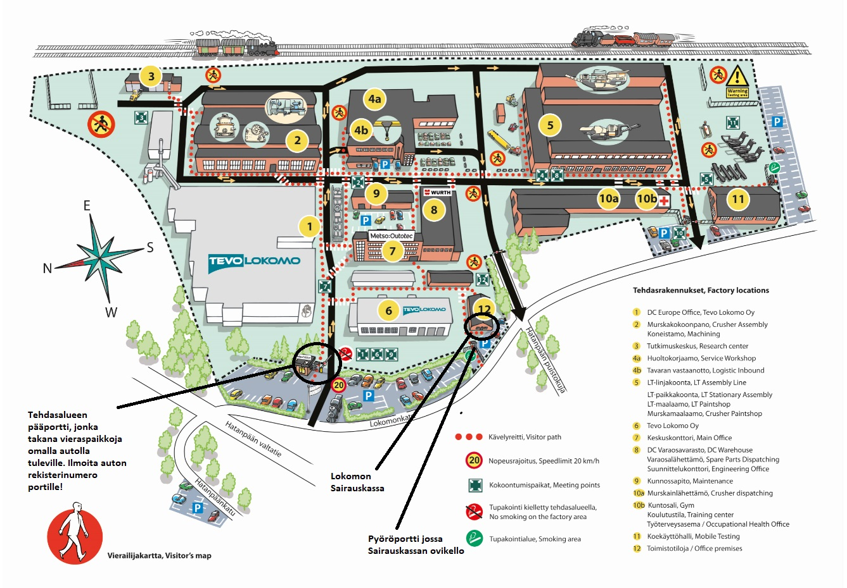

Slide 4
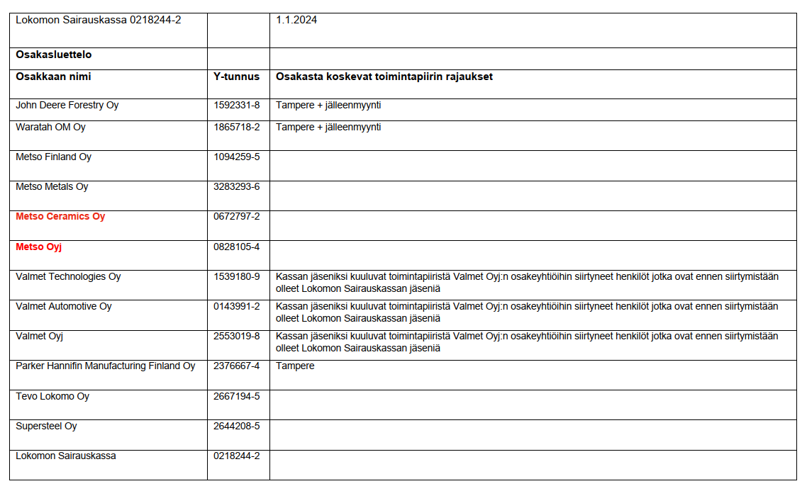
Lokomo’s Sickness Fund’s sphere of operationsphere of operation

Slide 5
Being insured
All employees and officials who work for employers within the sphere of Lokomo’s Sickness Fund are insured by the Sickness Fund.
Insurance memberships are automatic (when an employment contract lasts for more than four months).
NOTE!
Personnel from Metso Oyj and Metso Ceramics Oy;
Rules of the Sickness Fund, Section 4, Subsection 3:
For the personnel of Metso Oyj and Metso Ceramics Oy, the shareholders added to the shareholder list on 1 January 2024, the applied reporting period shall be the same as in the previous subsection (3 months). The personnel added to the sickness fund must submit a notification between 1 April and 30 June 2024 if they do not wish to join the sickness fund of Lokomo. As of July 1, 2024, the mandatory insurance will also apply to the personnel of the aforementioned shareholders. Persons who did not join at this time will not be able to join the fund at a later stage, unless otherwise stated in these regulations.

Slide 6
Insurance contribution
The insurance contribution is 1.1% of gross pay. The membership fee cap is €50.00/month.
Persons who have been members of the Sickness Fund for 15 years before their retirement or the end of their employment can become retired or other insurees.
For retired insurees, the membership fee is 1.7% of their gross pension.
The membership fee for other insurees is €24.00/month.

Slide 7
The workplace fund as a concept
A workplace fund is an insurance fund compliant with the Public Insurance Funds Act that has received permission from Kela to provide its members with benefits in accordance with the Health Insurance Act.
Some Finnish sickness funds are supplementary funds that do not grant Kela benefits.
In addition to its own operations, Lokomo’s Sickness Fund manages two supplementary funds:
- UTC’s Sickness Fund
- Tamfelt’s Sickness Fund
Finland currently has a total of 52 workplace funds and 70 supplementary funds
Workplace funds are guided by the same guidelines as Kela and use the same systems

Slide 8
Sickness Fund administration 1/2
Legally independent entities
Independently managed
The board of Lokomo’s Sickness Fund has nine (9) members who represent the employees, officials and senior officials. The shareholders are represented on the board by Paula Aura from Metso Outotec Finland
The Fund employs a CEO and
two insurance secretaries
Aulikki Juntunen from Medical Center Aava, Tampere
Board members are elected at an ordinary fund meeting held in November
CEO Taina Tuominen, tel. +358 50 317 3884, taina.tuominen@metso.com
Insurance Secretary Hanna Hautamäki, tel. +358 50 505 6394, hanna.hautamaki@metso.com
Insurance Secretary Sirpa Olán, tel. +358 50 317 1668, sirpa.olan@metso.com
Kela, workplace funds’ specialist physician unit
The following serve as Lokomo’s Sickness Fund’s specialist physicians:

Slide 9
Sickness Fund administration 2/2
The highest decision-making power is held by the fund meeting, which any insuree may attend
The ordinary fund meetings are held twice a year (April and November)
Financial statements meeting in April
Board members’ election in November
The fund meeting decides on rule amendments proposed by the board

Slide 10
Operational regulation and control
Sickness Fund operations governed by
Sickness Fund operations monitored by
Kela benefits
  Health Insurance Act
  Kela’s benefit guidelines
Additional Sickness Fund benefits
  Act on Company and Industry-wide Pension Funds
    Public Insurance Funds Act
  Sickness Fund rules
Financial Supervisory Authority
Kela
Finnish Financial Ombudsman Bureau (FINE)
Sickness Fund board

Slide 11
Benefits managed by the workplace fund 1/2
Kela benefits
Health care compensation:
Medication compensation
Sickness allowances
Special care allowance
Parental allowances
Kela handles any other member benefits than those listed above
doctor’s fees
dentist’s fees
examination and treatment (prescribed by dentist or doctor)
travel

Slide 12
Benefits managed by the workplace fund 2/2
The Sickness Fund’s own additional benefits
  Doctor’s fees (incl. admin fees)
  Psychologist’s and psychotherapist’s fees
  Public healthcare:
    outpatient clinic fees
    health center fees
    serial treatment fees
    ambulatory surgery treatment fees
    day ward fees
    hospital-at-home and homecare fees in connection with hospital care; available for up to four months per calendar year
    hospital fees for treating the same illness are compensated for according to the lowest payment category for up to 180 days
  Medication
  Examination and treatment
    laboratory tests
    pathology examinations
    imaging
  Travel
  Assistive equipment
  Glasses
  Dental care
  Physiotherapy and massage
  Podiatry
  Funeral allowance

Slide 13
Applying for benefits
Insured members of the Sickness Fund can apply for benefits electronically through Kela’s website
-> forwarded automatically to the Fund for processing
Direct Kela compensation from service providers (Sickness Fund’s billing agreements)
E-channel recommended when applying for additional benefits (secure connection), link on Sickness Fund website (https://lokomonsairauskassa.fi/korvausten-hakeminen-sahkoinen-asiointi, in Finnish)
You can also view and amend your personal information (address, bank details) via this channel.
Documents can be submitted in paper format (internal postal system at Lokomo, the post box is located by the Sickness Fund door) or via email (please note that this channel is not data secure).
As with Kela benefits, additional sickness fund benefits may be applied for retrospectively within six months.

Slide 14
Health care compensation
ADDITIONAL BENEFITS
SECTION 14
The Fund compensates its insurees for necessary treatment by a doctor or other appropriate professional due to sickness, pregnancy or childbirth. This compensation covers the actual cost of treatment, but – without jeopardizing the health of the insured individual in question – excludes any unnecessary costs. Within the context of these guidelines, dentists are also regarded as doctors.

Slide 15
Examples of compensation:
Doctor’s fees
  Without a referral, the compensation covers 80%
  With a referral from an occupational health doctor, the compensation covers 100% of specialist’s fees
  Ophthalmologist, gynecologist, urologist: no referral needed, compensation 100%
  Kela compensation covers €30 of costs
  Many private clinics also charge an administrative fee, compensation 80%

Slide 16
Examples of compensation:
Lokomo’s Sickness Fund compensates for 80% of the cost of examinations and treatments prescribed by a physician
Which things count as examinations and treatments?
laboratory tests
endoscopy through natural orifices
pathology examinations
imaging (e.g. ultrasound, x-ray and magnetic resonance imaging)
minor procedures during a doctor’s appointment, e.g. mole removal
(esophagoscopy, gastroscopy, duodenoscopy, colonoscopy, sigmoidoscopy)
Notes:
esophagoscopy: esophagus
gastroscopy: esophagus, stomach, duodenum
duodenoscopy: duodenum
colonoscopy: colon
sigmoidoscopy: sigmoid colon

Slide 17
Examples of compensation:
Public health care is covered in full:
outpatient clinic fees
Compensation for assistive equipment
€300.00 for acquiring the first items; compensation may be paid out again after three years from the first compensation
Typical assistive equipment includes various types of supports and insoles
Travel allowance
Necessary travel and accommodation costs for receiving treatment; the most inexpensive mode of transportation must be used, unless another mode is necessary because of the nature of the illness or traffic conditions (trips eligible for Kela compensation).
health center fees
serial treatment fees
ambulatory surgery treatment fees
day ward fees
hospital-at-home and homecare fees in connection with hospital care; available for up to four months per calendar year
hospital fees for treating the same illness are compensated for according to the lowest payment category for up to 180 days
Doctor’s referral required

Slide 18
Examples of compensation:
Medication compensation
Initial excess will not be reimbursed
Excess €5.00/drug
Medications that are eligible for Kela compensation and have been prescribed by a doctor are covered
Reference price system
Insurees’ rights to special medication compensation are processed by the Fund
Billed for directly by partner pharmacies
Podiatry
Compensation 75%
Need for treatment must be ascertained at a practice; an occupational health doctor’s referral is required
Three (3) treatment sessions in a series are eligible for compensation with a single referral
The treatment must be provided by a trained podiatrist

Slide 19
Examples of compensation:
Physical treatment
  Compensation for physical treatment is 75%; no more than eight treatment sessions with a single referral
  An (occupational health) doctor’s referral is required
  pay the cost yourself and send the receipts to the Sickness Fund for reimbursement.
Massage
  Compensation in accordance with the annual compensation cap, which in 2024 is €160.00/year
  Doctor’s referral not required
  Members can choose their treatment provider, who must be a trained massage therapist
  (a right to use the professional title of a massage therapist can be verified via Valvira’s JulkiTerhikki service: https://julkiterhikki.valvira.fi/?lang=fi)
  Massage compensation can also be used for treatment provided by a chiropractor, naprapath or osteopath.
  No direct billing: insurees must pay the fees themselves and afterward apply for compensation from the Sickness Fund. The receipts must indicate the members, i.e., treatment recipient’s details, the treatment cost, the details of the massage therapist and the bank account to which the compensation is to be paid out.

Slide 20
Examples of compensation:
Dental care
  Kela compensation for dental care costs is paid according to currently valid rates.
  Dental care allowance of €380.00 per calendar year is available as an additional benefit (requires that the insuree has been with the Fund for at least a year before the first compensation can be paid out).
  X-rays taken as part of dental care = examination and treatment = compensation 80% (does not reduce dental care allowance); a 20% excess is deducted from the remaining dental care allowance.
  A payment commitment is accepted as a payment instrument by contractual dentists. The Sickness Fund can provide these documents. Request one before seeking dental care.
  You can also go to the clinic of your choice, pay the fees or request an invoice and deliver the documents to the Sickness Fund.
  Paying the fees in full is recommended (including the proportion covered by Kela compensation). This speeds up the processing of the overall compensation (additional benefit).
  It is possible to receive compensation for prosthetic care, orthodontic treatment and other similar dental laboratory work: the maximum additional compensation amount equals the dental care allowance (€380).

Slide 21
Examples of compensation:
Glasses allowance
  €450.00 every three years
  €300.00 every two years
  Requires that the individual has been insured by the fund for at least a year before the first compensation can be paid out (€300.00).
  A payment commitment is accepted by our partner opticians. Contact the Sickness Fund to obtain one.
  You can also obtain glasses from a provider of your choice, pay the costs and apply for compensation from the Sickness Fund (please ensure that the receipt indicates the customer’s name).
  An amount equal to the glasses allowance is also available to be used for refractive eye surgery.
  Compensation is available for glasses if they have been prescribed by a doctor or an optician; the lenses must also have been ground for the purpose of correcting a deficiency in eyesight.

Slide 22
Surgery or other more expensive procedures at a private hospital
On a case-by-case basis, compensation may be paid out for treatment provided by a private hospital.
A COMPENSATION APPLICATION MUST ALWAYS BE SUBMITTED TO THE SICKNESS FUND BOARD IN ADVANCE.
Private clinics include Pihlajalinna, Mehiläinen and Suomen Terveystalo.
A COMPENSATION APPLICATION MUST DETAIL THE PROCEDURE, COST ESTIMATE AND COMPARABLE HEALTH CARE OPTIONS AVAILABLE IN THE PUBLIC SECTOR.
Compensation of 80% can be provided for the service fee of a private hospital (procedural fee), up to a maximum of €1,500.00.
Additional information and support with submitting an application is available from the Sickness Fund.

Slide 23
More information:
www.lokomonsairauskassa.fi/in-english
www.kela.fi

